Slide 1

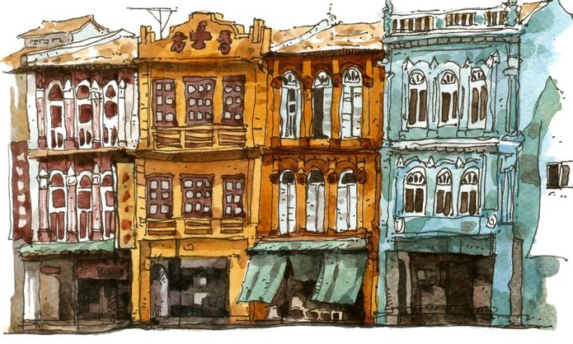
AIA Studio - AI for Building Performance
Predicting optimal layout configurations towards
Sustainable Conservation of Heritage Shophouses
MASTER IN ADVANCED COMPUTATION FOR ARCHITECTURE & DESIGN
2023/2024
3 June 2024
G04 - Faizan Shah, Elnaz Eshghkooh, Naree Phinyawatana, Naveen Kumar

Slide 2
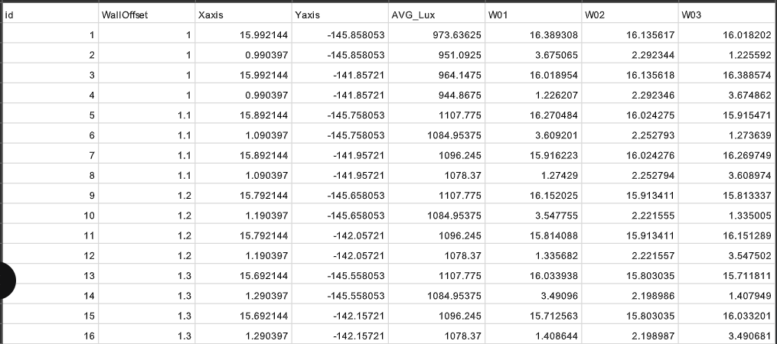
Development from Last Week
Hope you all had a productive week :)
Following up on last week's pitches, tomorrow we are starting with a 3 (min) presentation from each group (S)/(AS), including 3 slides in total and structured as follows:
1 slide/1 (min) - Project Idea: In short, this should describe what is the aim of your project and why.
1 slide/1 (min) - Project Methodology: This should include a set of methods/tasks and the assigned role for each team member.
1 slide/1 (min) - Blockers: A list of project-specific questions that need to be addressed during the breakout sessions.
Data set with correlation to window placement of shophouse facade (Distance in meters)
Y = Average Illuminance of Table ID
AIA Studio // Sustainable Conservation of Heritage Shophouses // G04

Slide 3
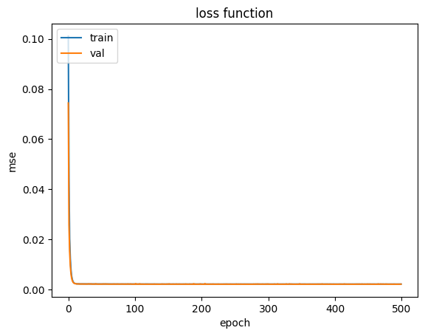
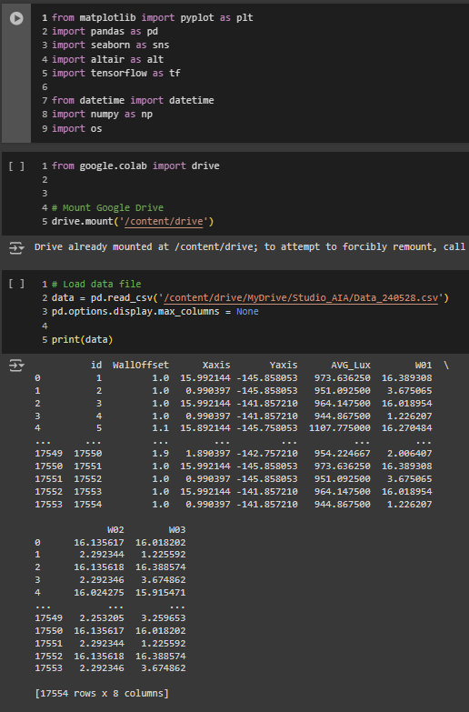
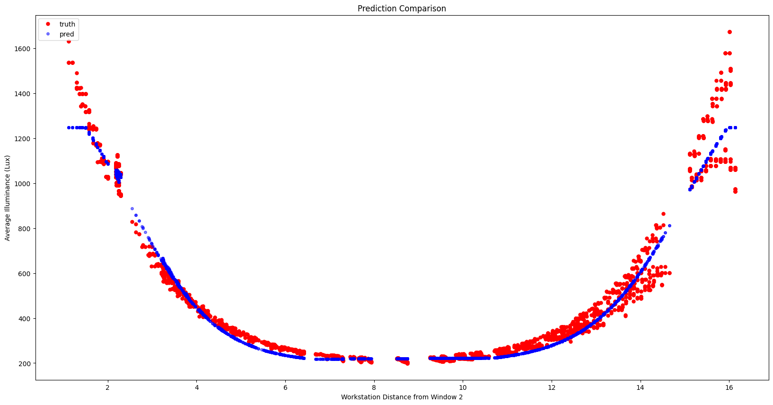
Development from Last Week
Hope you all had a productive week :)
Following up on last week's pitches, tomorrow we are starting with a 3 (min) presentation from each group (S)/(AS), including 3 slides in total and structured as follows:
1 slide/1 (min) - Project Idea: In short, this should describe what is the aim of your project and why.
1 slide/1 (min) - Project Methodology: This should include a set of methods/tasks and the assigned role for each team member.
1 slide/1 (min) - Blockers: A list of project-specific questions that need to be addressed during the breakout sessions.
Import to ANN Regression Model and train with predicted data
AIA Studio // Sustainable Conservation of Heritage Shophouses // G04

Slide 4
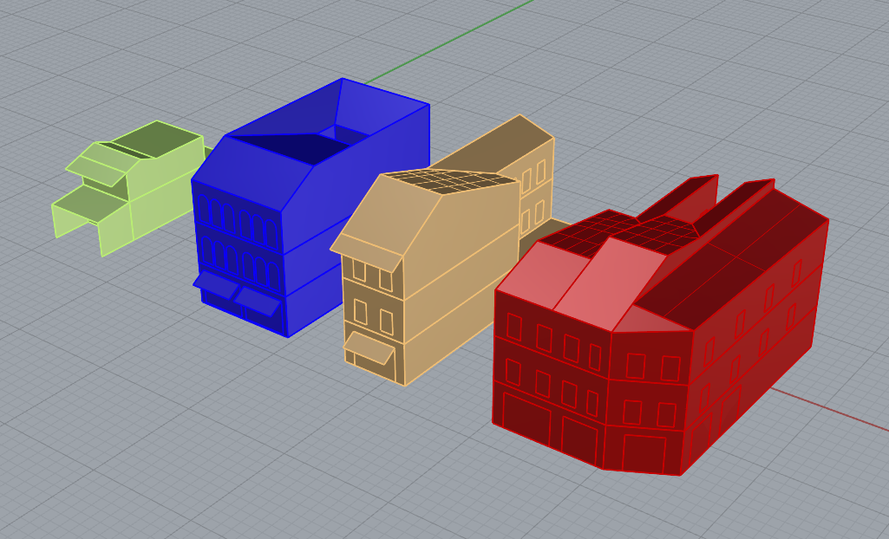
Development from Last Week
Hope you all had a productive week :)
Following up on last week's pitches, tomorrow we are starting with a 3 (min) presentation from each group (S)/(AS), including 3 slides in total and structured as follows:
1 slide/1 (min) - Project Idea: In short, this should describe what is the aim of your project and why.
1 slide/1 (min) - Project Methodology: This should include a set of methods/tasks and the assigned role for each team member.
1 slide/1 (min) - Blockers: A list of project-specific questions that need to be addressed during the breakout sessions.
Generate more variety of shophouses for run, train and test later
AIA Studio // Sustainable Conservation of Heritage Shophouses // G04

Slide 5
Workplan for the next two weeks
Hope you all had a productive week :)
Following up on last week's pitches, tomorrow we are starting with a 3 (min) presentation from each group (S)/(AS), including 3 slides in total and structured as follows:
1 slide/1 (min) - Project Idea: In short, this should describe what is the aim of your project and why.
1 slide/1 (min) - Project Methodology: This should include a set of methods/tasks and the assigned role for each team member.
1 slide/1 (min) - Blockers: A list of project-specific questions that need to be addressed during the breakout sessions.
June 2 to June 9
G04 ANN Regression Model in VS
Run to obtain output
in VS
Create Rhino/Hob Output Link
Test to import geometry in Rhino and look up value via hob
June 17 to June 23
June 10 to June 16
Final Presentation
Finalise online web portal for input and output
Test to import geometry in Rhino and look up value via hob
Add in 4 other shophouse typologies with the same method above to increase dataset and predicted outputs
AIA Studio // Sustainable Conservation of Heritage Shophouses // G04

Slide 6
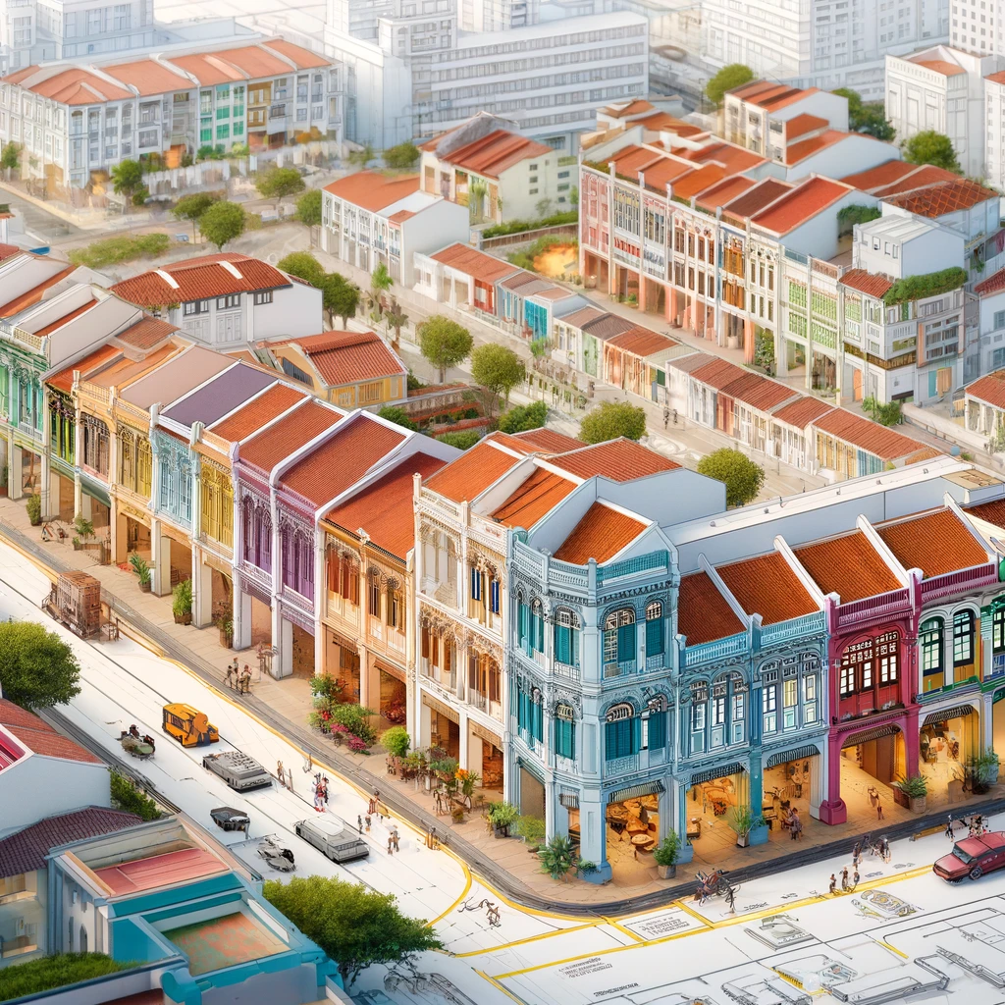
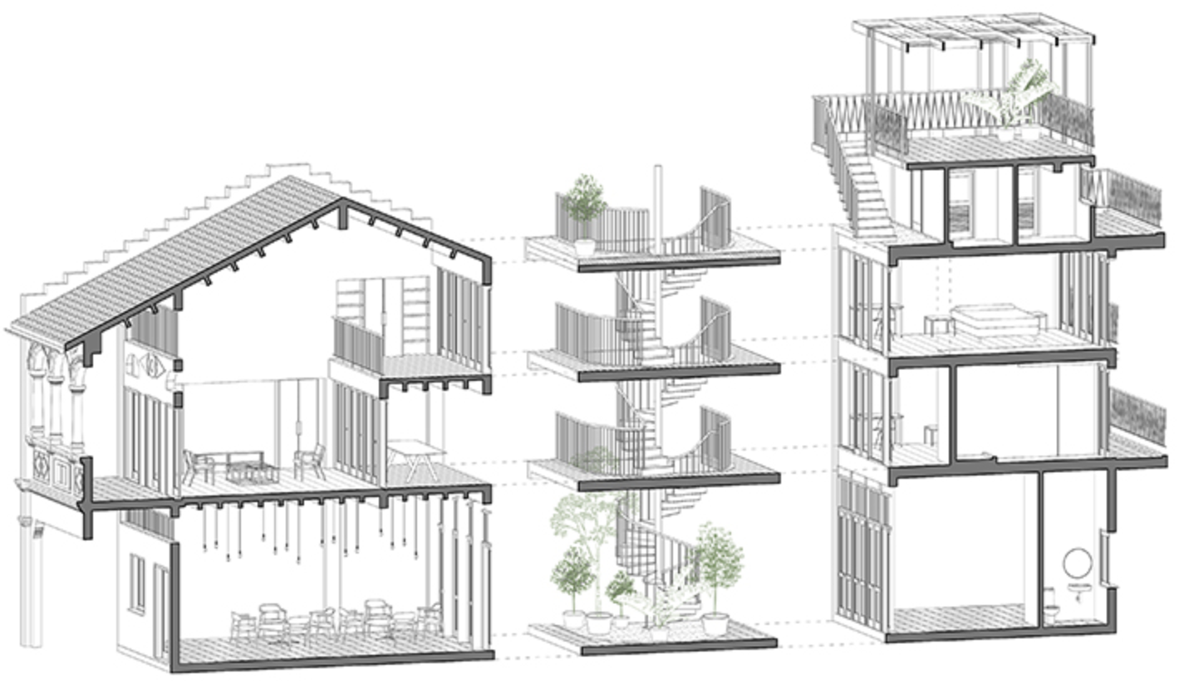

Project Idea
Hope you all had a productive week :)
Following up on last week's pitches, tomorrow we are starting with a 3 (min) presentation from each group (S)/(AS), including 3 slides in total and structured as follows:
1 slide/1 (min) - Project Idea: In short, this should describe what is the aim of your project and why.
1 slide/1 (min) - Project Methodology: This should include a set of methods/tasks and the assigned role for each team member.
1 slide/1 (min) - Blockers: A list of project-specific questions that need to be addressed during the breakout sessions.
Our project aims to determine suitable workstation arrangement for office typology in a conservation shophouse in Singapore through maximise daylight on the worksurface to achieve 300 lux (to a maximum of 3000 lux) for good lighting condition.
Why?
In a conservation shophouse, where the building envelope and facade cannot be altered. There are two daylight sources into the space through the front facade windows and either back facade windows or light shaft.
AIA Studio // Sustainable Conservation of Heritage Shophouses // G04

Slide 7
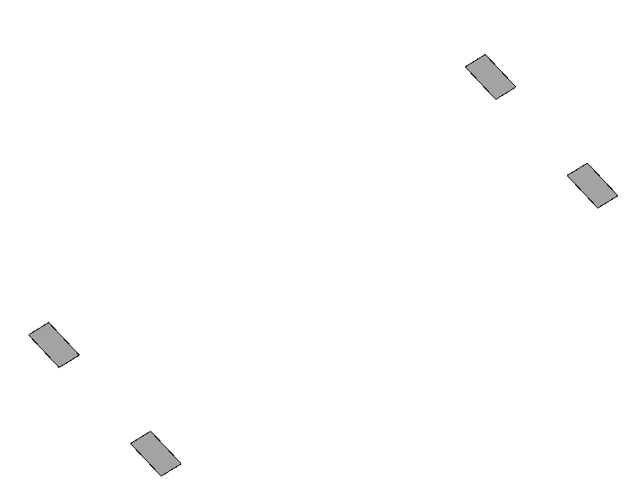
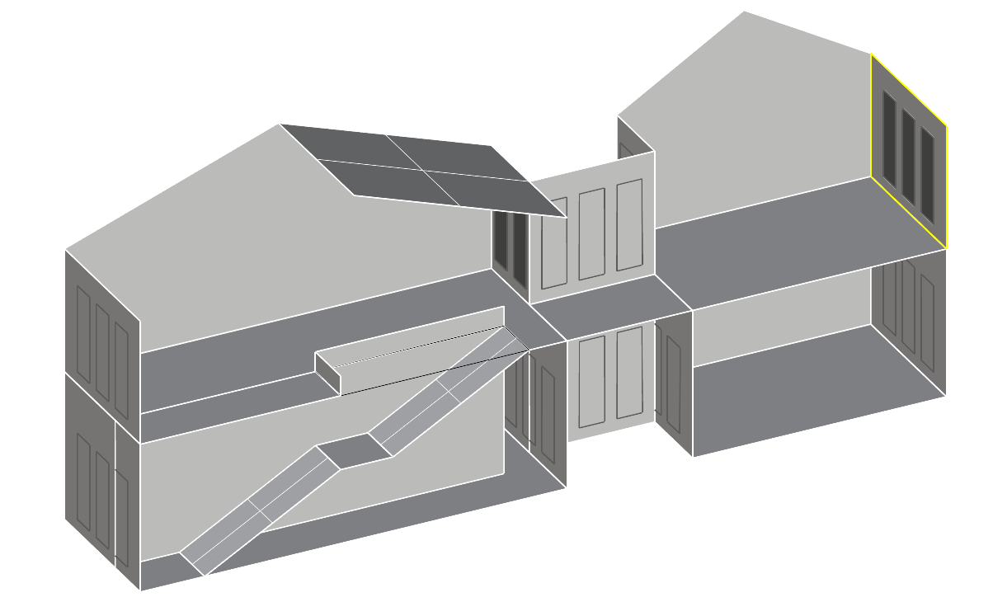
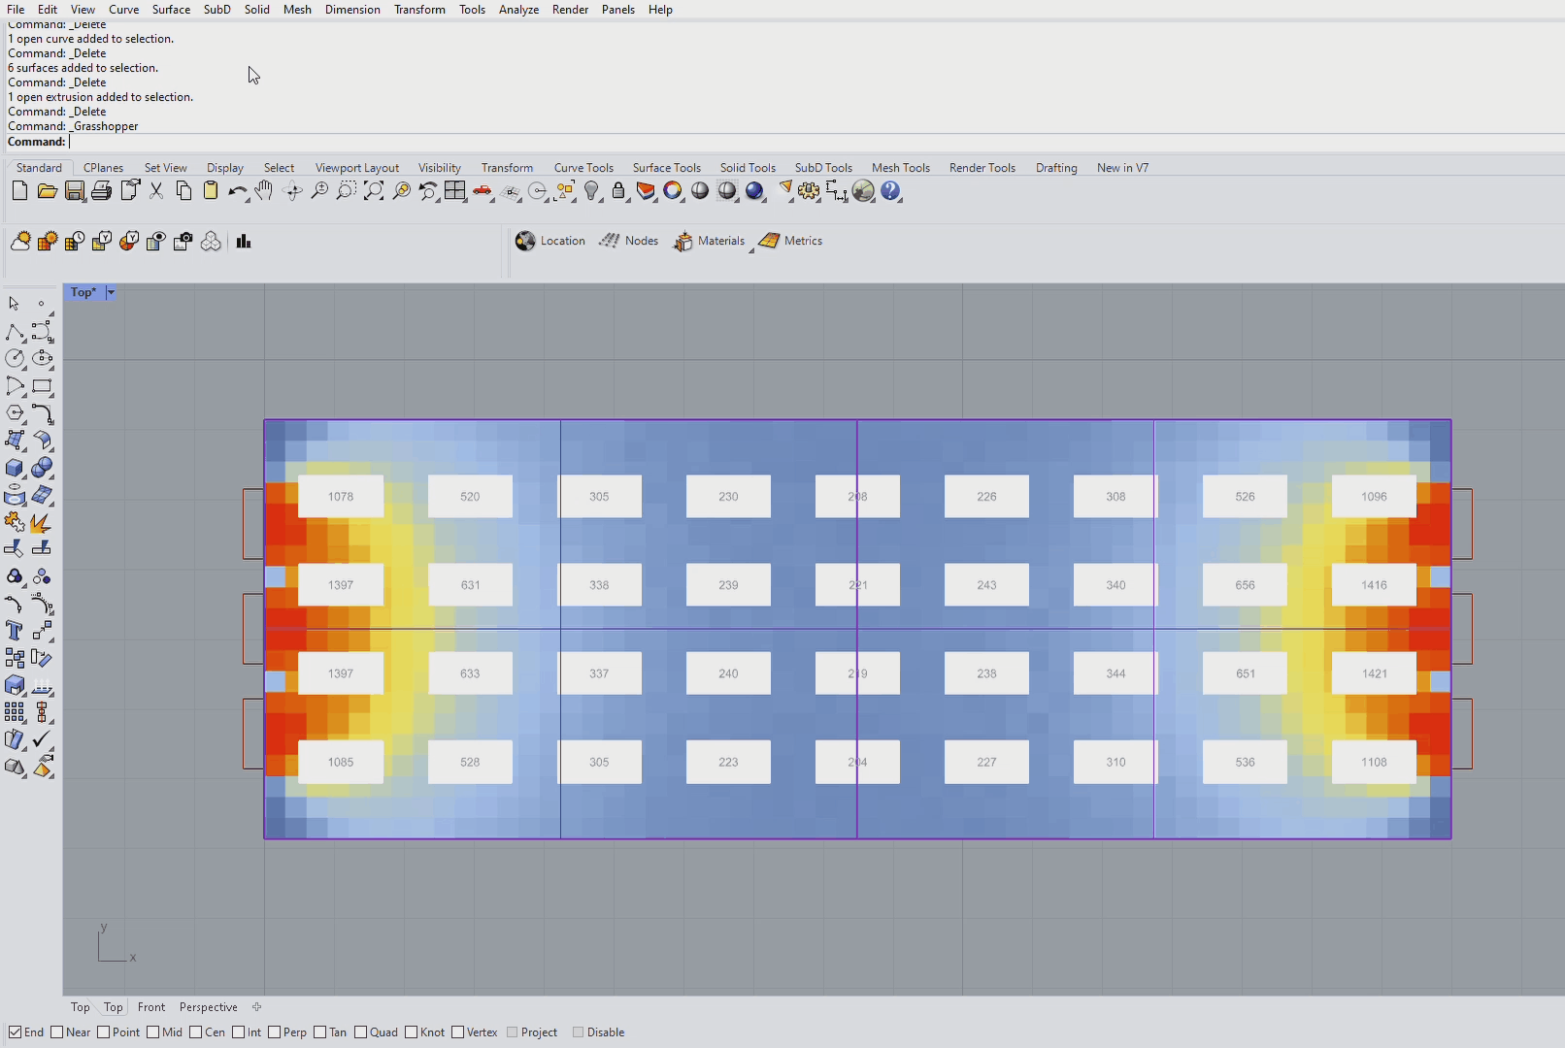
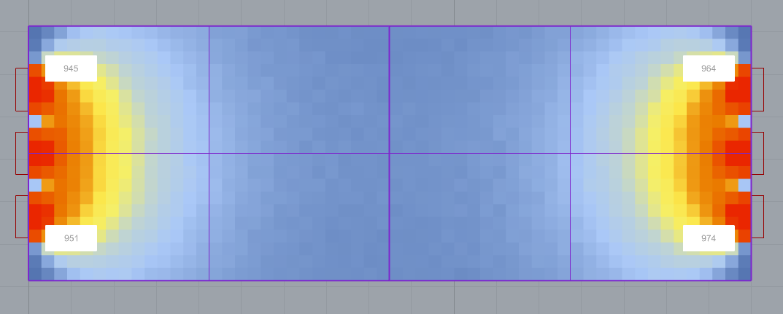
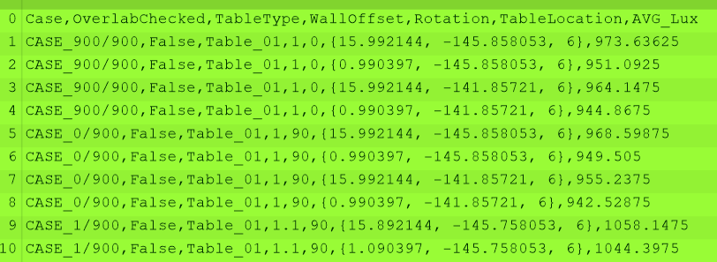
Project Methodology
Hope you all had a productive week :)
Following up on last week's pitches, tomorrow we are starting with a 3 (min) presentation from each group (S)/(AS), including 3 slides in total and structured as follows:
1 slide/1 (min) - Project Idea: In short, this should describe what is the aim of your project and why.
1 slide/1 (min) - Project Methodology: This should include a set of methods/tasks and the assigned role for each team member.
1 slide/1 (min) - Blockers: A list of project-specific questions that need to be addressed during the breakout sessions.
Develop SG Shophouse
Building Envelope
Run Daylight Simulation
(Average Illuminance) on a Typical Floor
Establish Workstation Configuration through Parametric Study
Pull up Average Illuminance per Desk
Get Desk X and Y coordinates
NAREE
NAVEEN/FAIZAN
NAREE
NAVEEN/FAIZAN
Use the data set to train on desk typology, lux, and coordinate for optimal desk location
ELNAZ
Allow user to input total workstation required and the model will predict possible workstation locations and arrangement based on the required workstation numbers
AIA Studio // Sustainable Conservation of Heritage Shophouses // G04

Slide 8
Blockers - Data Outputs
Able to pull out average illuminance per table and xy coordinate of each table configuration
Outputs over 2,000 data sets
Is the data set sufficient and how to we use the data to set up ML part?
Pull up Average Illuminance per Desk
Get Desk X and Y coordinates
https://docs.google.com/spreadsheets/d/12BLRjrf4191OblvGhXRAqFeCCPQr3sFR/edit?usp=sharing&ouid=114705677363835525867&rtpof=true&sd=true
AIA Studio // Sustainable Conservation of Heritage Shophouses // G04

Slide 10
